Slide 1
FRB Update #1
William Huang
6/13/2020

Slide 2
Why is there S/N=0 and what does it mean?
Why: I included all FRBs from ASKAP, CHIME, and Parkes, regardless of S/N ratio. For some reason, the only S/N below 6 was 0.
What does S/N=0 mean?
I’m not sure. However, I did find that this mostly occurred for the CHIME telescope exclusively, and as you can see on the next page, some events that had observations within multiple telescopes had different S/N ratios, some of which were not 0. An example FRB like this is FRB180916.J0158+65.
I have contacted one of the authors of the catalogue about the issue. I may hear a response in a few days.

Slide 3
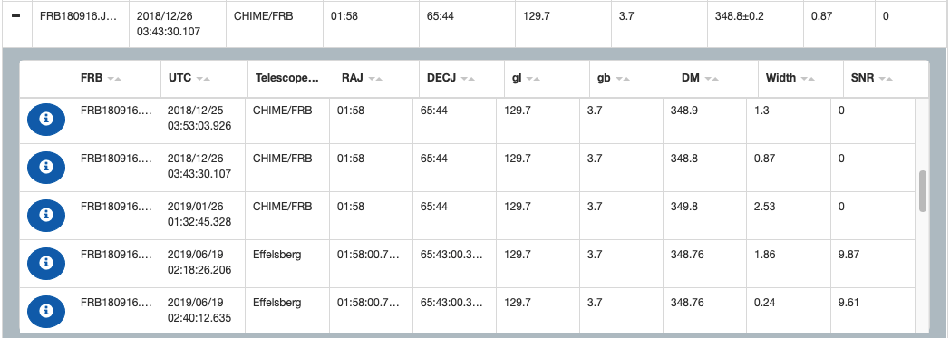
Picture of Multiple S/N ratios for One Event

Slide 4
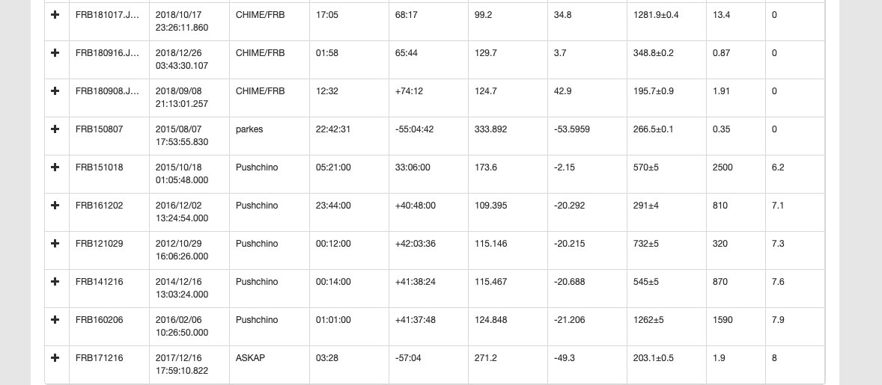
Why is there no S/N from 6–7?
I’m not sure; even when we include all of the FRBs, there is an abrupt jump from 0 to 6. However, the S/N = 6.2–7.9 only comes from the telescope Pushchino.

Slide 5
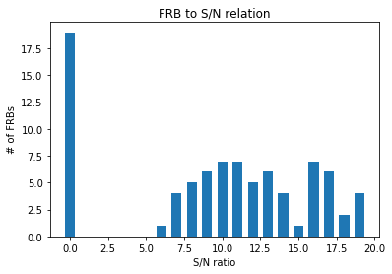
(continued)
Here is a bar graph of all the S/N ratios of every FRB in the catalogue, including those not from the 3 major telescopes:
Bin width is 1. There are no FRBs in the catalog with 0 < S/N < 5.

Slide 6




Calculating
Out of the 90 FRBs from ASKAP, CHIME, and Parkes
63 have max flux, S/N, luminosity distance and redshift data
Out of those 63
54 have S/N > 6, the rest have S/N = 0
I used your equations:
And I used a Python program to calculate Kendall’s tau statistic between them.

Slide 7
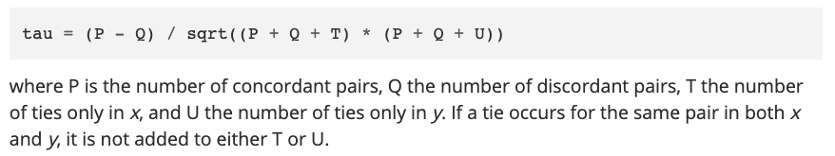
(cont).
I used the scipy.stats.kendalltau from Python to perform this. It uses the following definition of Kendall’s tau:
Documentation is here: https://docs.scipy.org/doc/scipy/reference/generated/scipy.stats.kendalltau.html

Slide 8
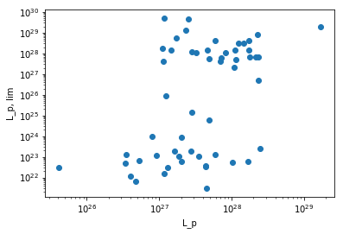
(cont.)
I obtained a value of 0.2916... for the initial values (k=0). I think this is reasonable, given the plot of L_p and L_{p,lim} below. Note that this is plotted on a log/log scale.

Slide 9


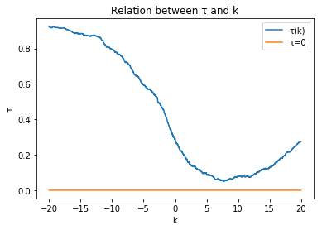
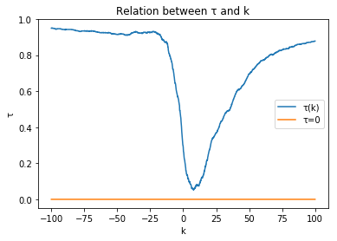
(cont.)
Then, I used and on both luminosity functions, and I calculated Kendall’s tau for various values of k, incremented by 0.01.
The left is -20 < k < 20, while the right is -100 < k < 100. The orange line represents tau = 0, demonstrating tau never reaches 0.

Slide 10
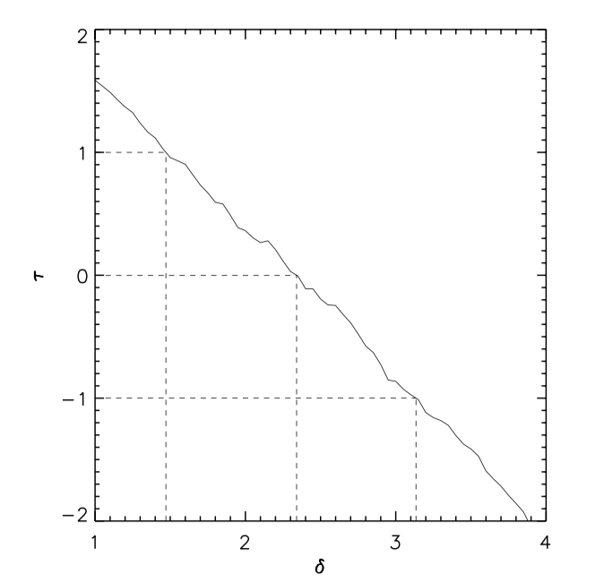
(cont.)
Unfortunately, I wasn’t able to find a single value of k that resulted in Kendall’s tau equal to zero. In fact, it was mostly between 0.1 < tau < 1, and it was never negative. I’m not sure why or what this means.
In your paper of cosmological evolution of long Gamma ray bursts, you had a picture in which tau crossed tau=0 in pretty much a straight line. I don’t see any similar behavior in the graph for FRBs.

